Slide 1

Université de Mostaganem — Dr. Madani BELACEL
ICT Tutorial 01 — Introduction to Information and Communication Techniques
Module TIC — Dr. BELACEL Madani
Université de Mostaganem — MCB

Slide 2
Université de Mostaganem — Dr. Madani BELACEL
🎯 Objectifs pédagogiques
• Comprendre les concepts clés
• Appliquer les compétences
• Évaluer les technologies

Slide 3
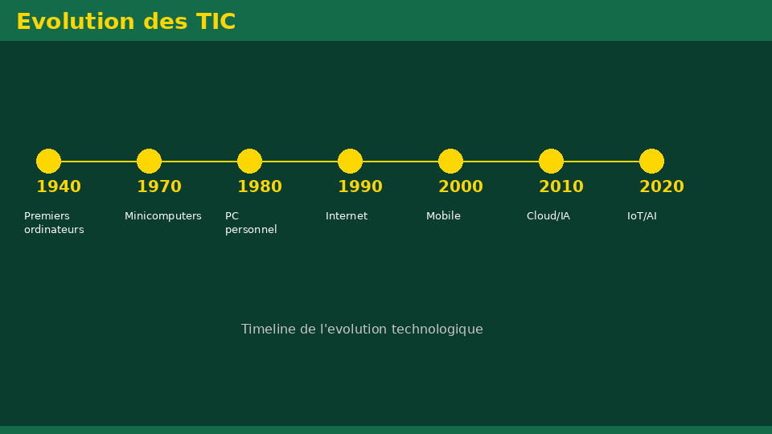
Université de Mostaganem — Dr. Madani BELACEL
📋 Plan du cours
• Exercise 1 — Personal definition(15 min)
• Exercise 2 — The three dimensions(15 min)
• Exercise 3 — ICT functions(18 min)
• Exercise 4 — Language applications(18 min)
• Exercise 5 — Critical thinking(14 min)

Slide 4
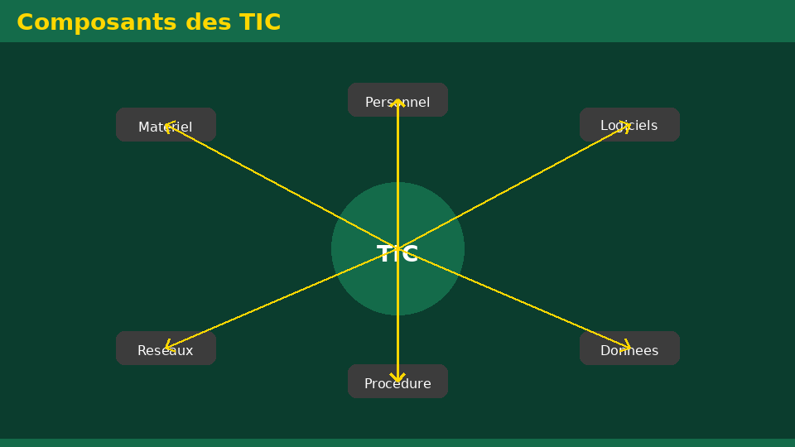
Exercise 1 — Personal definition(15 min)
• Statement:Give your own definition of ICT in 2-3 lines, then compare it to the ITU definition.
• Detailed correction:ICT brings together digital tools for processing, transmission and access to information. The ITU emphasizes digital form and the convergence of technologies.
Université de Mostaganem — Dr. Madani BELACEL

Slide 5
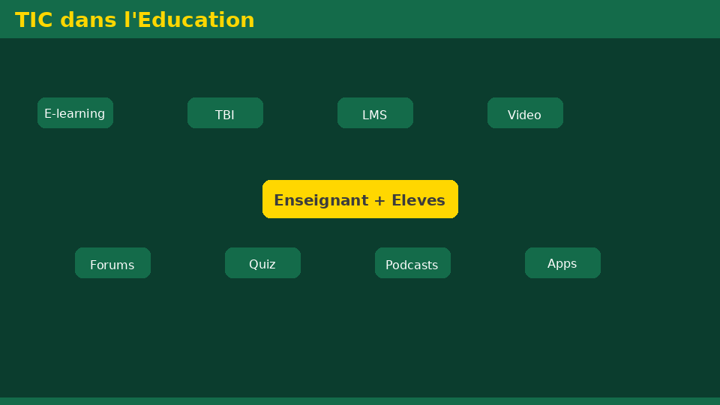
Exercise 2 — The three dimensions(15 min)
• Statement:Explain with personal examples the three dimensions: Techniques, Information, Communication.
• Detailed correction:Technical = PC + Moodle; Information = PDF handout; Communication = email to teacher or TD forum.
Université de Mostaganem — Dr. Madani BELACEL

Slide 6
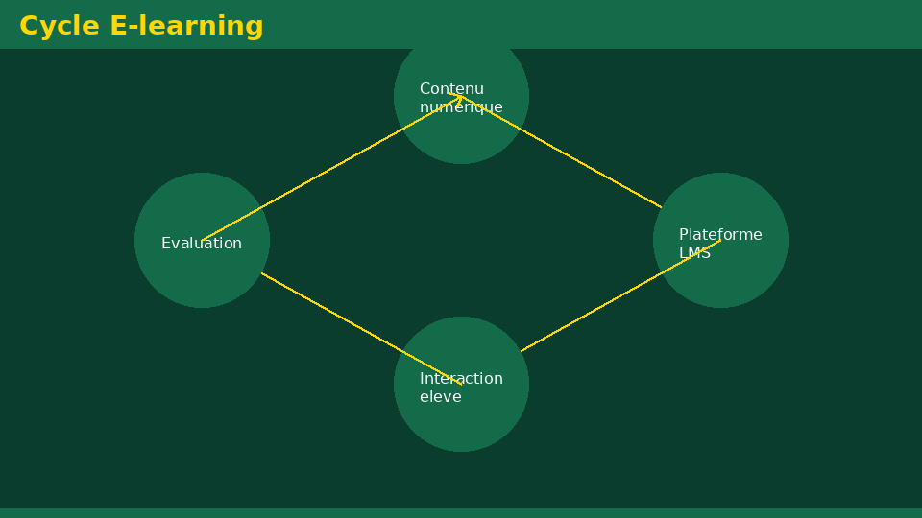
Exercise 3 — ICT functions(18 min)
• Statement:For each action, identify the function: processing / transmission / backup. Word writing, email sending, USB copying, Teams videoconferencing, PDF printing.
• Detailed correction:Word → processing; email and Teams → transmission; USB → backup; printing → processing/output.
Université de Mostaganem — Dr. Madani BELACEL

Slide 7
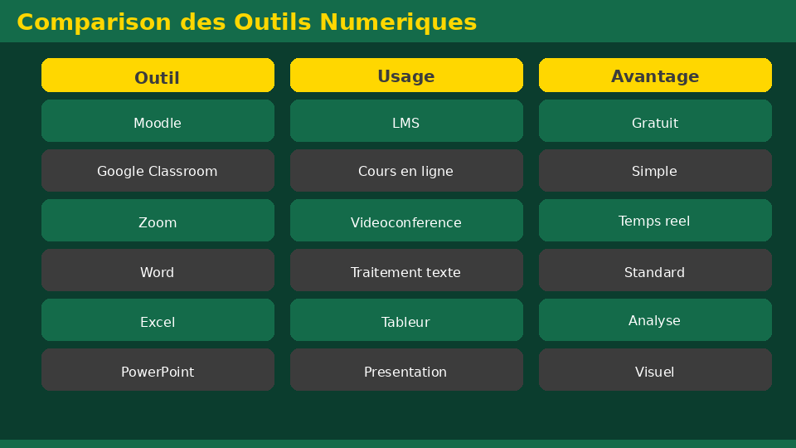
Exercise 4 — Language applications(18 min)
• Statement:Name 5 concrete uses of ICT for a foreign language student.
• Detailed correction:Online multilingual corpora, video with native speakers, Moodle for homework, digital library, PowerPoint for presentations.
Université de Mostaganem — Dr. Madani BELACEL

Slide 8
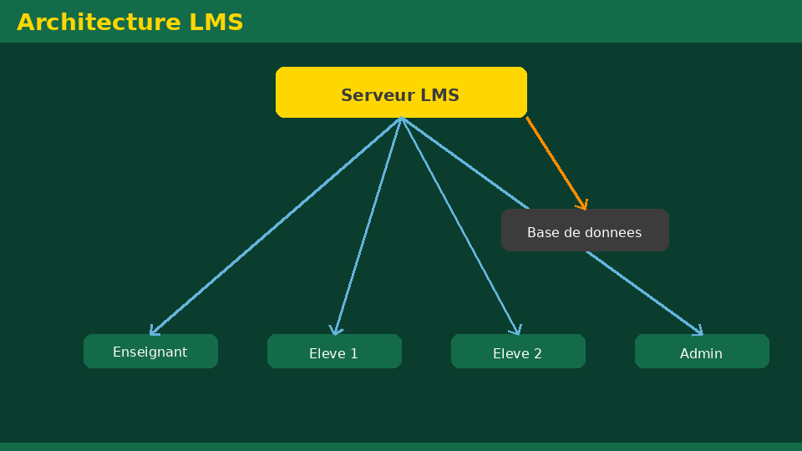
Exercise 5 — Critical thinking(14 min)
• Statement:Write a paragraph (10-12 lines) on the opportunities and risks of ICT for language students.
• Detailed correction:Opportunities: global resources, MOOCs, collaboration. Risks: plagiarism, misinformation, addiction, privacy. Posture: critical thinking and academic ethics.
Université de Mostaganem — Dr. Madani BELACEL

Slide 9
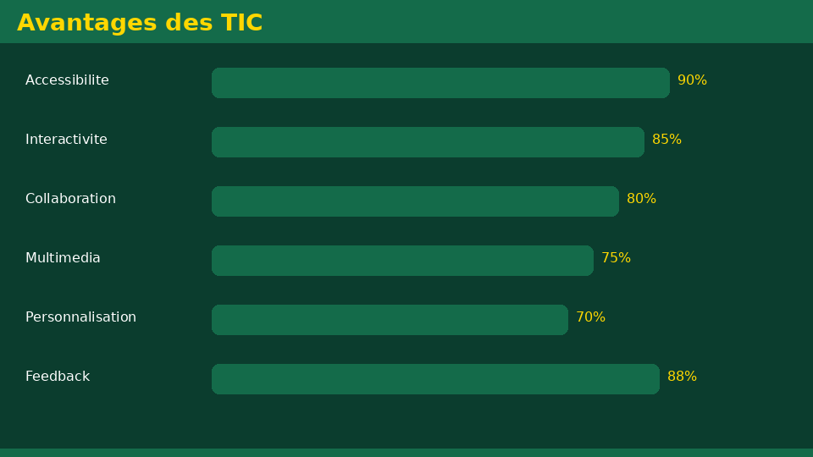
• Statement:Give your own definition of ICT in 2-3 lines, then compare it to the ITU definition.
• Statement:Explain with personal examples the three dimensions: Techniques, Information, Communication.
• Statement:For each action, identify the function: processing / transmission / backup. Word writing, email sending, USB copying, Teams videoconferencing, PDF printing.
📝 Points clés à retenir
Université de Mostaganem — Dr. Madani BELACEL

Slide 10
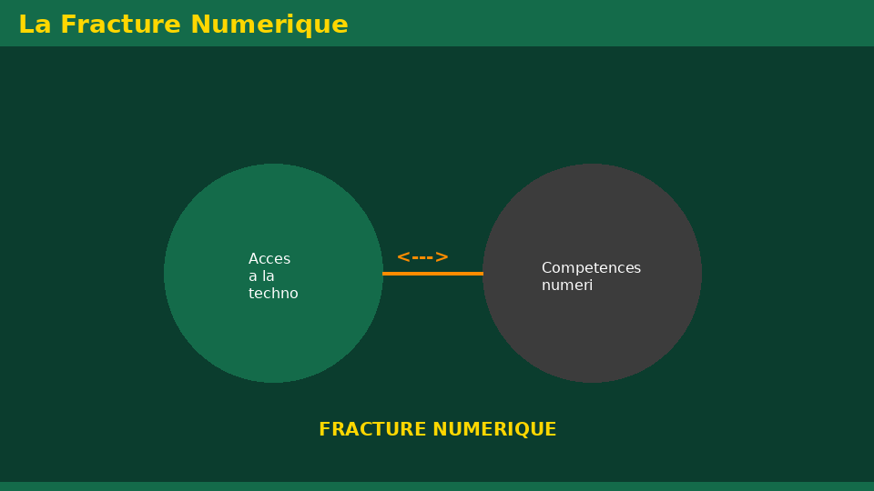
• Statement:Give your own definition of ICT in 2-3 lines, then compare it to the ITU definition.
• Statement:Explain with personal examples the three dimensions: Techniques, Information, Communication.
• Statement:For each action, identify the function: processing / transmission / backup. Word writing, email sending, USB copying, Teams videoconferencing, PDF printing.
📝 Points clés à retenir
Université de Mostaganem — Dr. Madani BELACEL

Slide 11
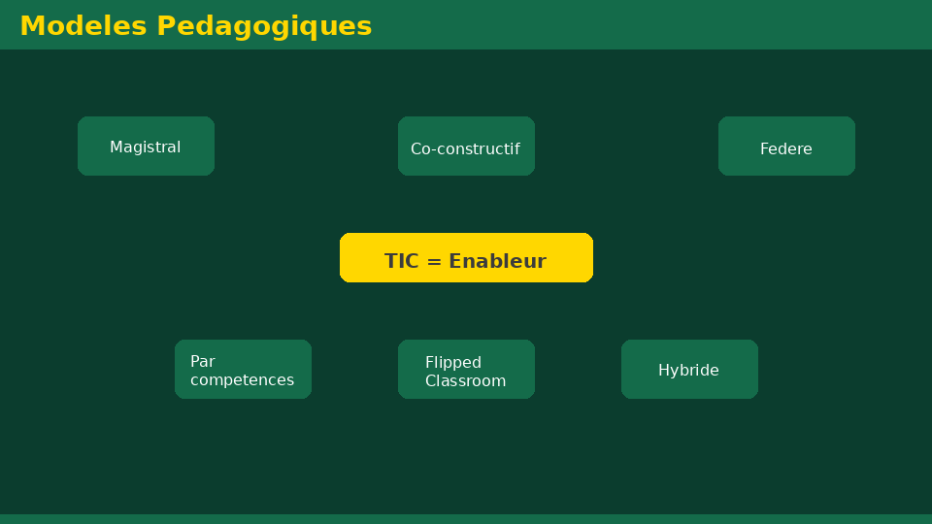
• Statement:Give your own definition of ICT in 2-3 lines, then compare it to the ITU definition.
• Statement:Explain with personal examples the three dimensions: Techniques, Information, Communication.
• Statement:For each action, identify the function: processing / transmission / backup. Word writing, email sending, USB copying, Teams videoconferencing, PDF printing.
📝 Points clés à retenir
Université de Mostaganem — Dr. Madani BELACEL

Slide 12
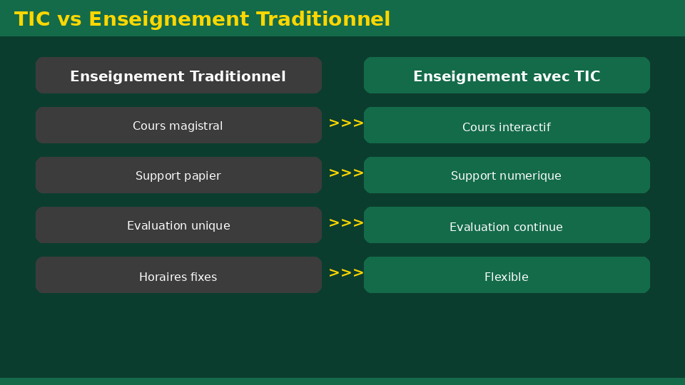
• Statement:Give your own definition of ICT in 2-3 lines, then compare it to the ITU definition.
• Statement:Explain with personal examples the three dimensions: Techniques, Information, Communication.
• Statement:For each action, identify the function: processing / transmission / backup. Word writing, email sending, USB copying, Teams videoconferencing, PDF printing.
📝 Points clés à retenir
Université de Mostaganem — Dr. Madani BELACEL

Slide 13
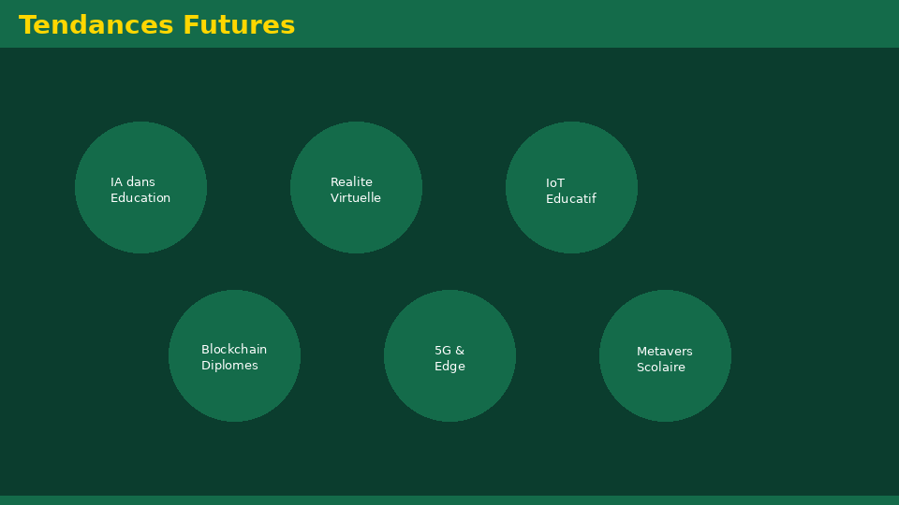
Université de Mostaganem — Dr. Madani BELACEL
📝 Points clés à retenir
• Statement:Give your own definition of ICT in 2-3 lines, then compare it to the ITU definition.
• Statement:Explain with personal examples the three dimensions: Techniques, Information, Communication.
• Statement:For each action, identify the function: processing / transmission / backup. Word writing, email sending, USB copying, Teams videoconferencing, PDF printing.
• Statement:Name 5 concrete uses of ICT for a foreign language student.
• Statement:Write a paragraph (10-12 lines) on the opportunities and risks of ICT for language students.

Slide 14
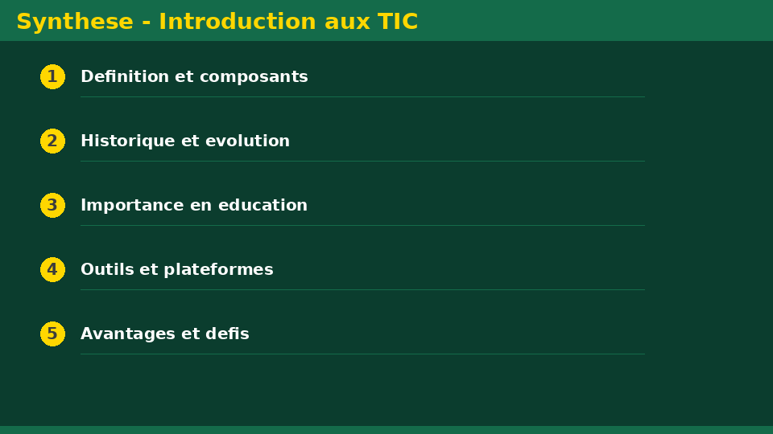
Université de Mostaganem — Dr. Madani BELACEL
✏️ Exercices d'application
• Définir les concepts principaux du cours
• Identifier les applications pratiques
• Résoudre les exercices du TD
• Synthétiser les points clés en un paragraphe
• Préparer une courte présentation orale

Slide 15
Université de Mostaganem — Dr. Madani BELACEL
🎓 Conclusion
Dr. BELACEL Madani Maître de Conférences B Université de Mostaganem madani.belacel@univ-mosta.dz

